Slide 1
IDS – 476: Business Forecasting Project
Group Members:
Adusumelli, Jaideep – 672039068 Kondathasula, Uday – 656467843 Chowdhury, Gaurav – 651395167 Kompella, Kaushik – 663144176 Sirothia, Shubham – 650889404 Thomas, Shobin – 657777256

Slide 2
Time Series Analysis of Aviation Data
Forecasting Monthly airline revenue passenger miles for SPIRIT Airlines

Slide 3
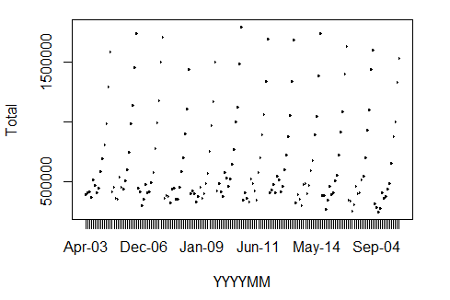
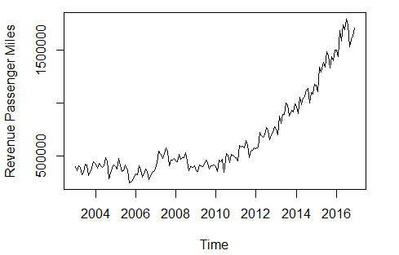
Data Source and Summary
Bureau of Transportation Statistics, Government of United States of America.
Our data consisted of:
168 rows : January 2003 to December 2016.
2 Columns: “Date” and “Passenger Revenue Miles”
> ls(rpm)
[1] "Total" "YYYYMM“

Slide 4
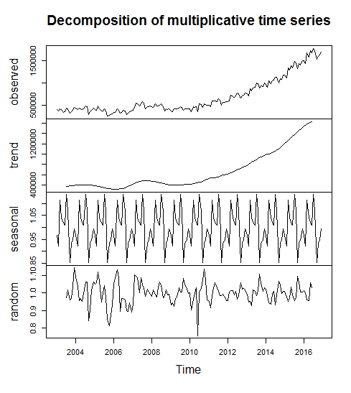
Decomposition of Time series
Additive Decomposition:
X_{t} = M_{t} + S_{t} + Z_{t}
Multiplicative Decomposition:
X_{t} = M_{t}*S_{t}*Z_{t}
Log(X_{t}) = M’_{t} + S’_{t} + Z’_{t}

Slide 5
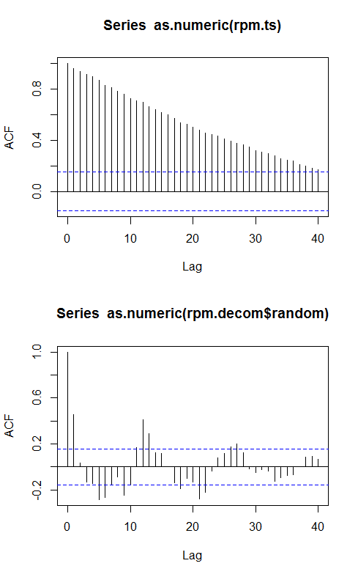
Auto correlation vs lag charts
Very high auto-Correlation in un decomposed data.
Seasonal effects can be seen in the acf chart of “random” factor of the decomposed data.

Slide 6
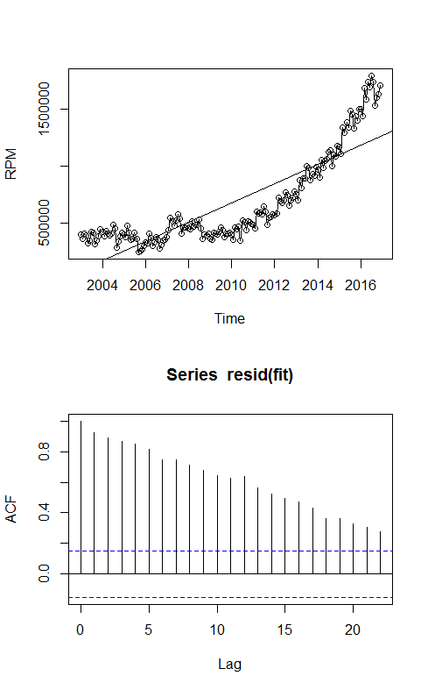
Model Fitting: Linear Model
Not a very good fit.
Doesn’t follow the trend of the data.
High auto-correlations.

Slide 7
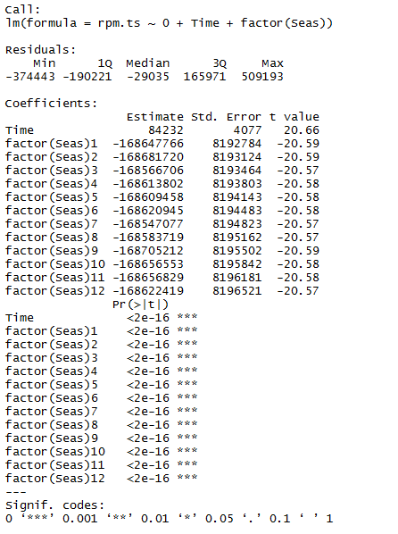
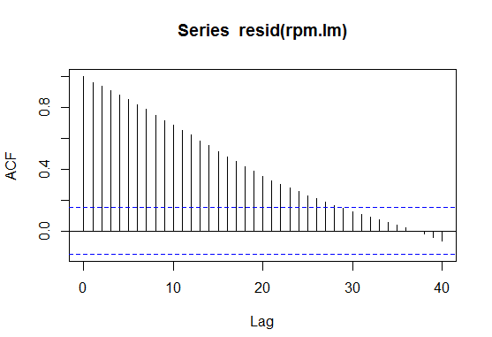
Model Fitting: Linear Models with seasonality
Strong positive auto-correlation
Residuals are not pure natural numbers. Hence further modelling required

Slide 8
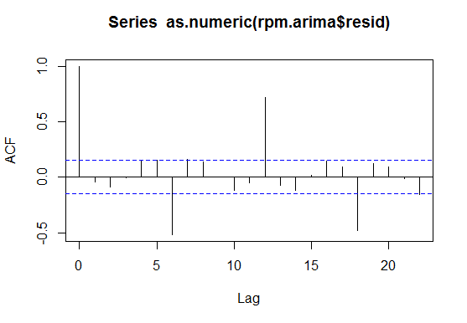
Model Fitting: ARIMA
Strong Seasonal Information left in the residuals.
Further modelling required to deal with this.

Slide 9
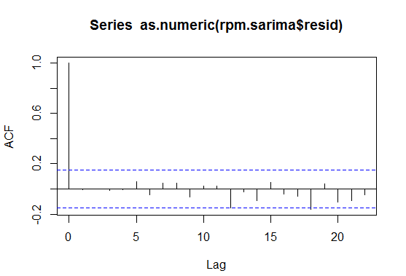
Model fitting: SARIMA
SARIMA: Seasonal ARIMA model
AR(1) and MA(1), with first order difference.
Seasonal term with frequency 12.
Good residual Auto-correlation graph.

Slide 10
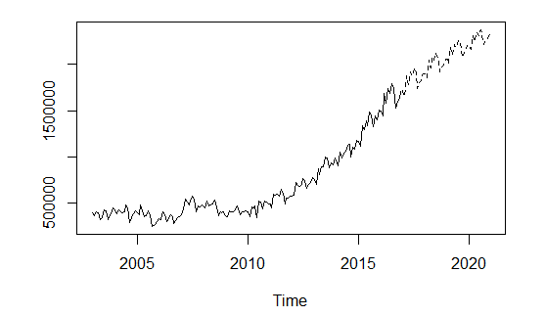
Forecasting
Prediction
Predicted future values of the “Passenger Revenue Miles”.
Graph of predicted data along with original data =>

Slide 11
Thank you

